Slide 1
Probability and Statistics
Dr Bakhtawar
Software Engineering
NUML Islamabad

Slide 2

Numerical Solution of Standard Deviation
Coefficient of Variation was introduced by Karl Pearson. It is used to compare the variation or to compare the performance of two sets of data.
Example: Calculate the variance, S.D and C.V from the following marks obtained by 9 students.

Slide 3
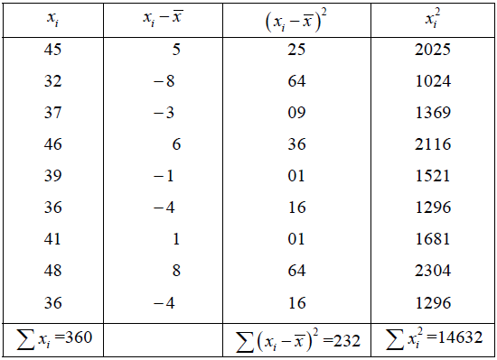
Numerical Solution of Standard Deviation

Slide 4
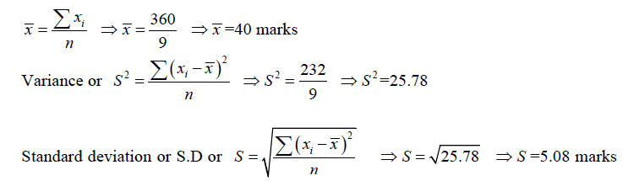
Numerical Solution of Standard Deviation

Slide 5
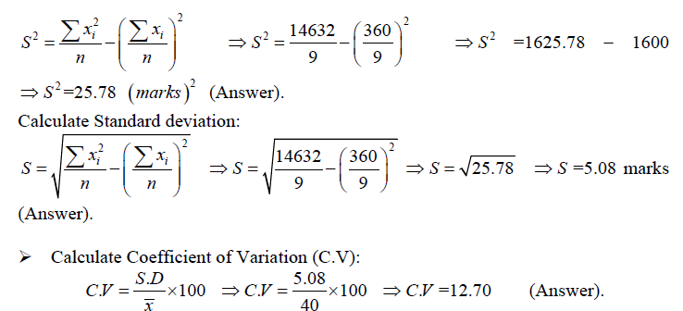
Alternative Way of Calculating Standard Deviation

Slide 6
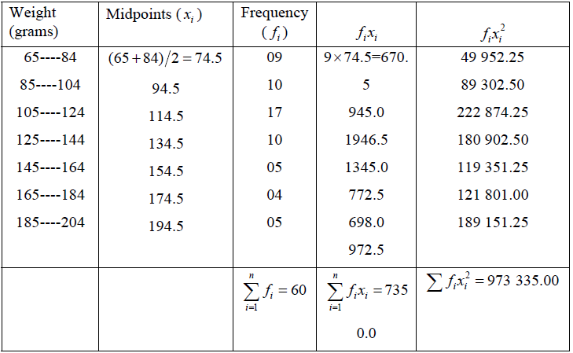
Numerical Solution of Standard Deviation for Grouped Data

Slide 7
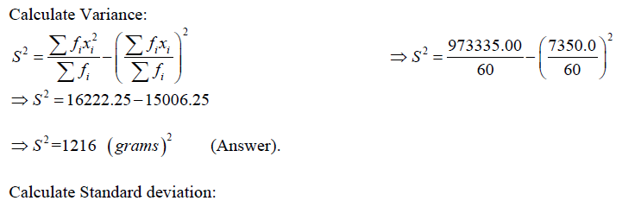
Numerical Solution of Standard Deviation for Grouped Data

Slide 8
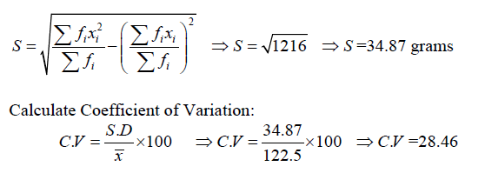
Numerical Solution of Standard Deviation for Grouped Data

Slide 9
Random Variables and Probability Distribution
In a statistical experiment, it is often very important to allocate numerical values to the outcomes.
Example:
· Experiment: testing two components. (D=defective, N=non-defective)
· Sample space: S={DD,DN,ND,NN}
· Let X = number of defective components when two components are tested.
· Assigned numerical values to the outcomes are:

Slide 10
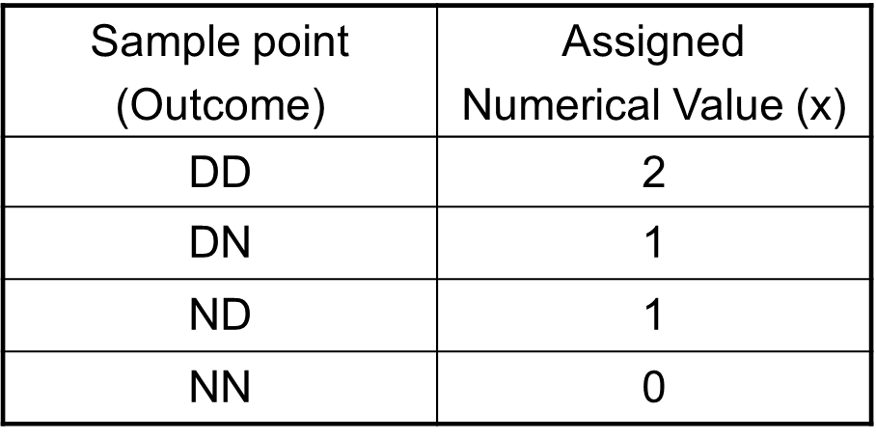
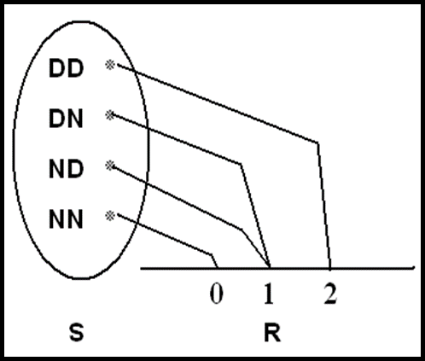
Random variables and Probability Distribution

Slide 11
Random variables and Probability Distribution
Example:
· Experiment: tossing a coin 2 times independently.
· H= head , T=tail
· Sample space: S={HH, HT, TH, TT}
· · Let X= number of heads
Sample Point Outcome | Numerical Value | Probability Distribution
DD | 2 | 2/4
DN | 1 | 1/4
ND | 1 | 1/4
NN | 0 | 0/4

Slide 12
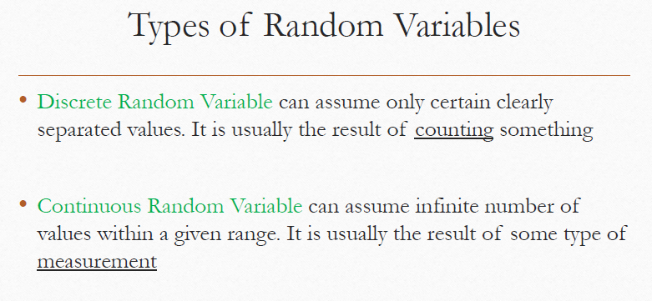

Slide 13
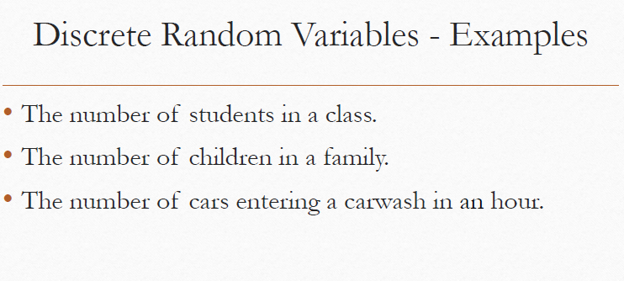

Slide 14
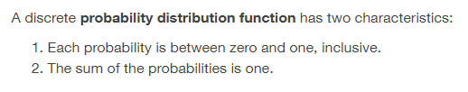

Slide 15
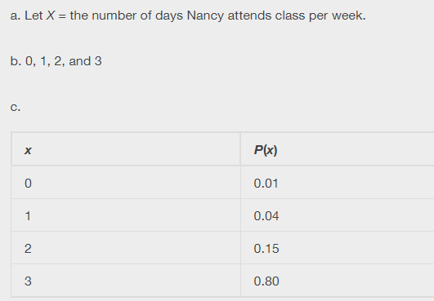

Slide 16
Discrete Probability Distributions
A discrete random variable X assumes each of its
values with a certain probability.
Example:
· Experiment: tossing a non-balance coin 2
times independently.
· H= head , T=tail
· Sample space: S={HH, HT, TH, TT}
· Suppose P(H)=1/3 and P(T)=2/3
· Let X= number of heads
Sample point (Outcome) | Probability | Value of X (x)
HH | P(HH)=P(H) P(H)=1/3×1/3 = 1/9 | 2
HT | P(HT)=P(H) P(T)=1/3×2/3 = 2/9 | 1
TH | P(TH)=P(T) P(H)=2/3×1/3 = 2/9 | 1
TT | P(TT)=P(T) P(T)=2/3×2/3 = 4/9 | 0

Slide 17
· The possible values of X are: 0, 1, and 2.
· X is a discrete random variable.
· Define the following events:
Event (X=x) | Probability = P(X=x)
(X=0)={TT} | P(X=0) = P(TT)=4/9
(X=1)={HT,TH} | P(X=1) =P(HT)+P(TH)=2/9+2/9=4/9
(X=2)={HH} | P(X=2) = P(HH)= 1/9
· The possible values of X with their probabilities are:
X | 0 | 1 | 2 | Total
P(X=x)=f(x) | 4/9 | 4/9 | 1/9 | 1.00
The function f(x)=P(X=x) is called the probability function
(probability distribution) of the discrete random variable X.

Slide 18
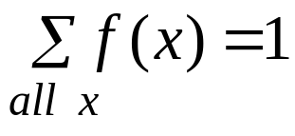
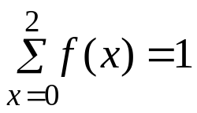
Definition
The function f(x) is a probability function of a discrete
random variable X if, for each possible values x, we have:
f(x) ≥ 0
f(x)= P(X=x)
Example:
For the previous example, we have:
X
0
1
2
Total
f(x)= P(X=x)
4/9
4/9
1/9

Slide 19
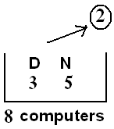
P(X<1) = P(X=0)=4/9
P(X≤1) = P(X=0) + P(X=1) = 4/9+4/9 = 8/9
P(X≥0.5) = P(X=1) + P(X=2) = 4/9+1/9 = 5/9
P(X>8) = P(φ) = 0
P(X<10) = P(X=0) + P(X=1) + P(X=2) = 1
Example
A shipment of 8 similar microcomputers to a retail outlet contains 3 that are defective and 5 are non-defective.
If a school makes a random purchase of 2 of these computers, find the probability distribution of the number of defectives.

Slide 20

Solution:
We need to find the probability distribution of the random variable: X = the number of defective computers purchased.
Experiment: selecting 2 computers at random out of 8
n(S) = equally likely outcomes
The possible values of X are: x=0, 1, 2. Consider the events:

Slide 21
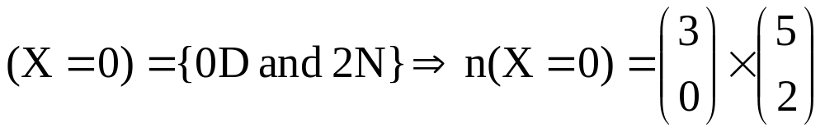
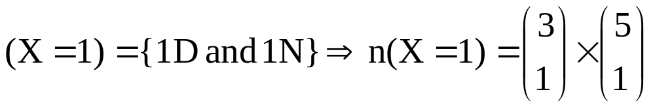
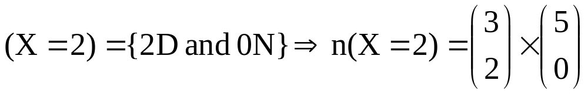
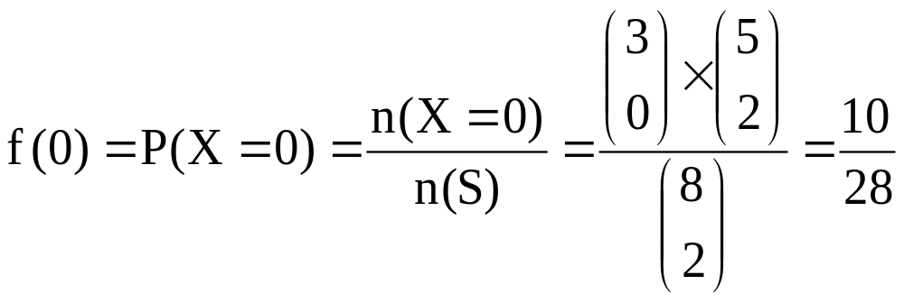

Slide 22
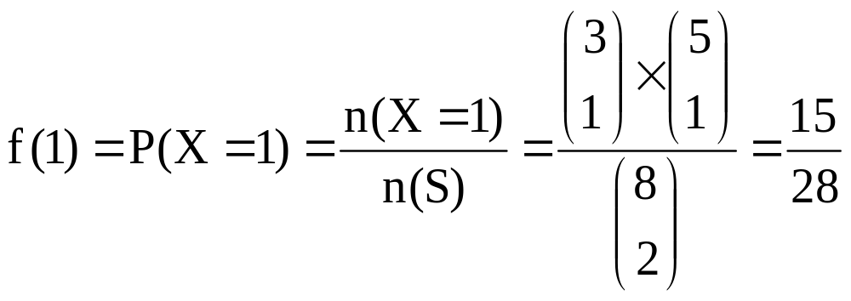
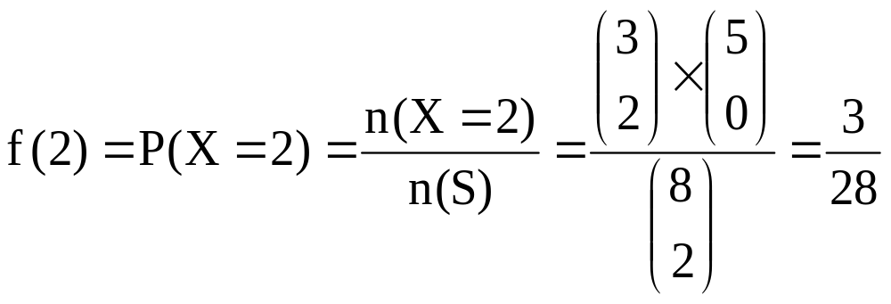

Slide 23



The probability distribution of X is:
x | 0 | 1 | 2 | Total
f(x)= P(X=x)
1.00

Slide 24


Slide 25
Thank you

